Slide 1
Advance Regression

Slide 2
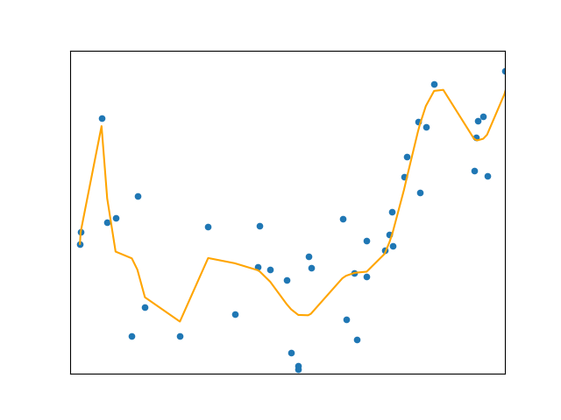
What is polynomial regression
Linear regression requires linear relation between dependent and independent variables
What if distribution of data is more complex?

Slide 3
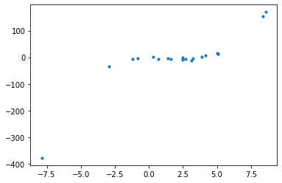
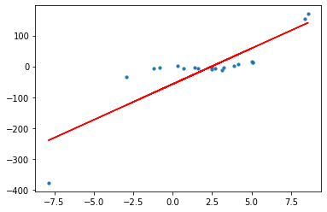
Why polynomial regression

Slide 4
Why polynomial regression
R2 Score: 0.6127145

Slide 5
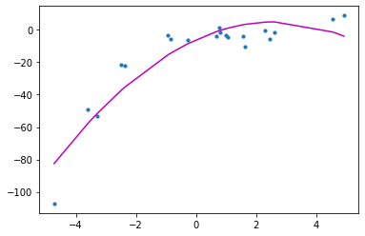
Why polynomial regression
R2 Score: 0.88

Slide 6
What is polynomial?
How many turning points does polynomial have?
Y = w₀+w₁x
Y = w₀+w₁x+w₂x² (Second degree polynomial)
As weights of associated features are linear hence this model is considered to be linear model but curve which we are trying to fit is quadratic.
X² is quadratic term.

Slide 7
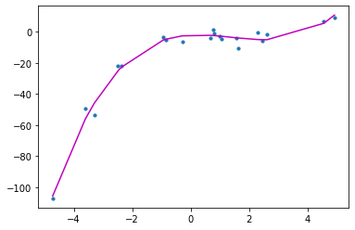
Why polynomial regression
R2 Score: 0.98

Slide 8
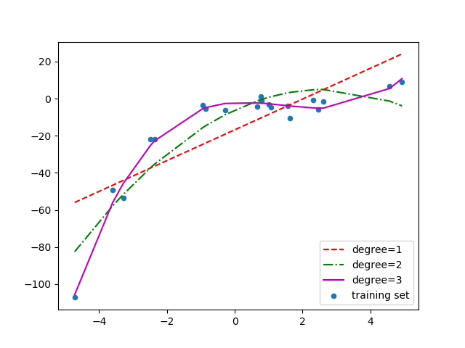
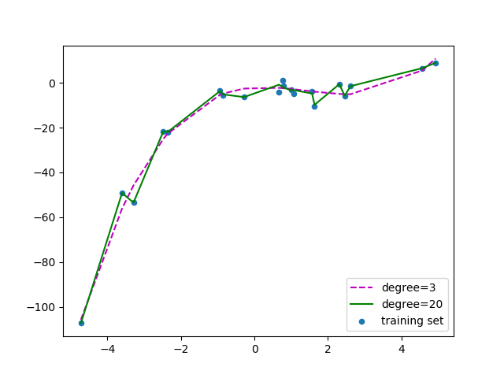
Which model is better?

Slide 9
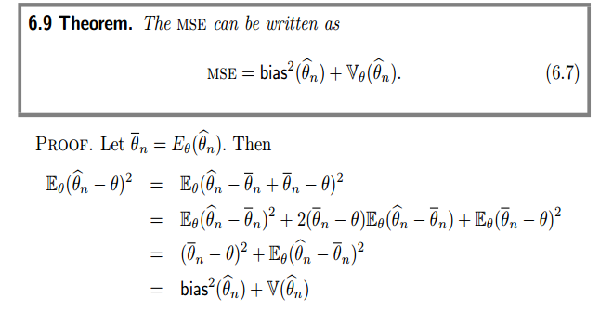
Bias Variance

Slide 10

Bias
Difference between expected value of estimator and True value.
An unbiased estimator is preferable to a biased estimator
But true unbiased estimator is impossible hence we select always some biased estimator
Underfitting
Bias refers to error due to models simple assumption

Slide 11
Variance of Estimator
Over fitting
More complex models
Model Captures noise in the data

Slide 12
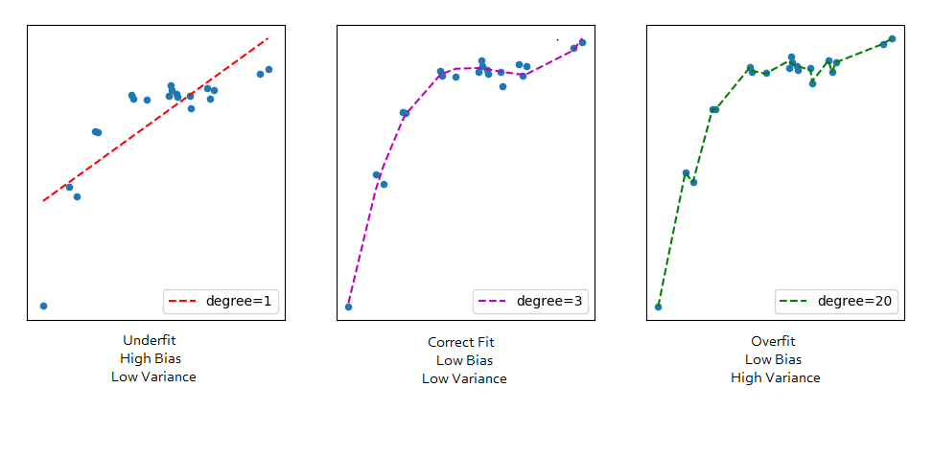
Bias Variance Tradeoff

Slide 13
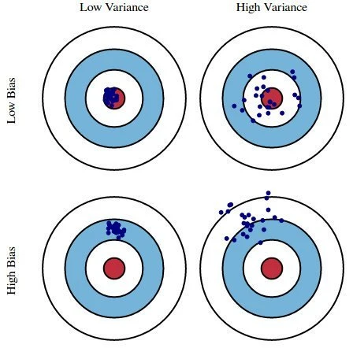
Bias Variance Tradeoff

Slide 14
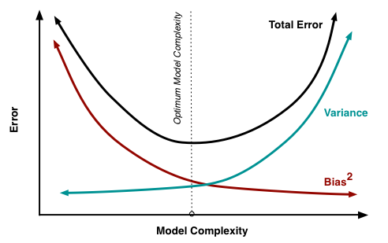
Bias Variance Tradeoff

Slide 15
Regularization
Ridge Regression(L2 Regularization)
Lasso Regression (L1 Regularization)

Slide 16
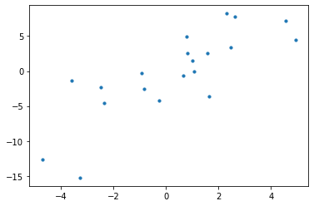
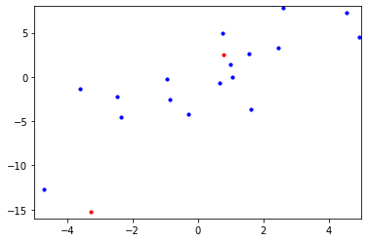
Ridge Regression

Slide 17
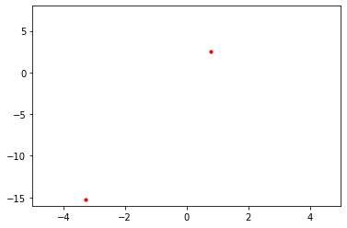
Ridge Regression

Slide 18
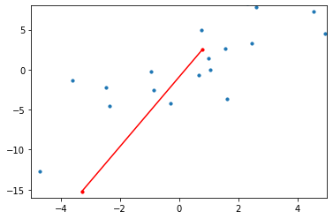
Ridge Regression
Is it overfitting?

Slide 19

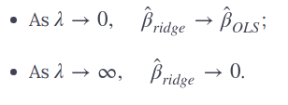
Ridge Regression
Ridge Regression tries to avoid overfitting by penalizing large coefficients
Ridge regression has additional factor lambda which is penalty factor
Ridge regression never applied to intercept
Lambda need to calculate using cross validation

Slide 20
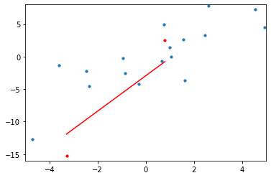
Ridge Regression
Ridge regression tries to minimize variance.
Ridge regression adds bias in the system.
as lambda increases bias increase
If number of training points are less the number of features then Ridge regression also used to find solution.
Decide lambda using cross validation

Slide 21
Assignment
Apply Ridge regression to advertising data
Cross validate and find out best lambda parameter

Slide 22

Lasso Regression
It is similar to ridge regression
Adds penalty to non zero coefficients
Lasso also increases bias and decreases variance
Only difference is it adds absolute values of parameters
Lasso Regression not only penalize B values but also it makes irrelevant B to zero.
As lambda value increases lasso regression also could make parameter values towards zero instead of tending to zero in ridge regression.

Slide 23
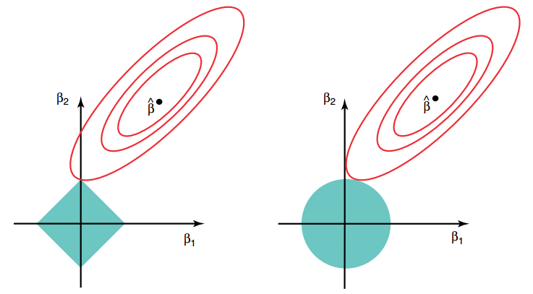
The Variable Selection Property of the Lasso

